Slide 1
Current fluctuations in open Quantum Systems
Bridging the gap between quantum continuous measurements and full counting statistics
arXiv:2303.04270
Michael Kewming, APS March Meeting
Gabriel Landi, Mark Mitchison, Patrick Potts

Slide 2
The topics in this tutorial
Pedagogical overview of Stochastic Quantum Master Equations (jumps, diffusion)
Develop an understanding continuous quantum measurements and output currents (charge counting, diffusive measurements)
Describe how one can compute key statistical quantities of output currents (two-time correlation functions, power spectrum)
Computation of higher order moments/distribution of outcomes (Full Counting statistics, tilted Liouvillian)
Numerous methods and techniques to evaluate all these concepts.

Slide 3



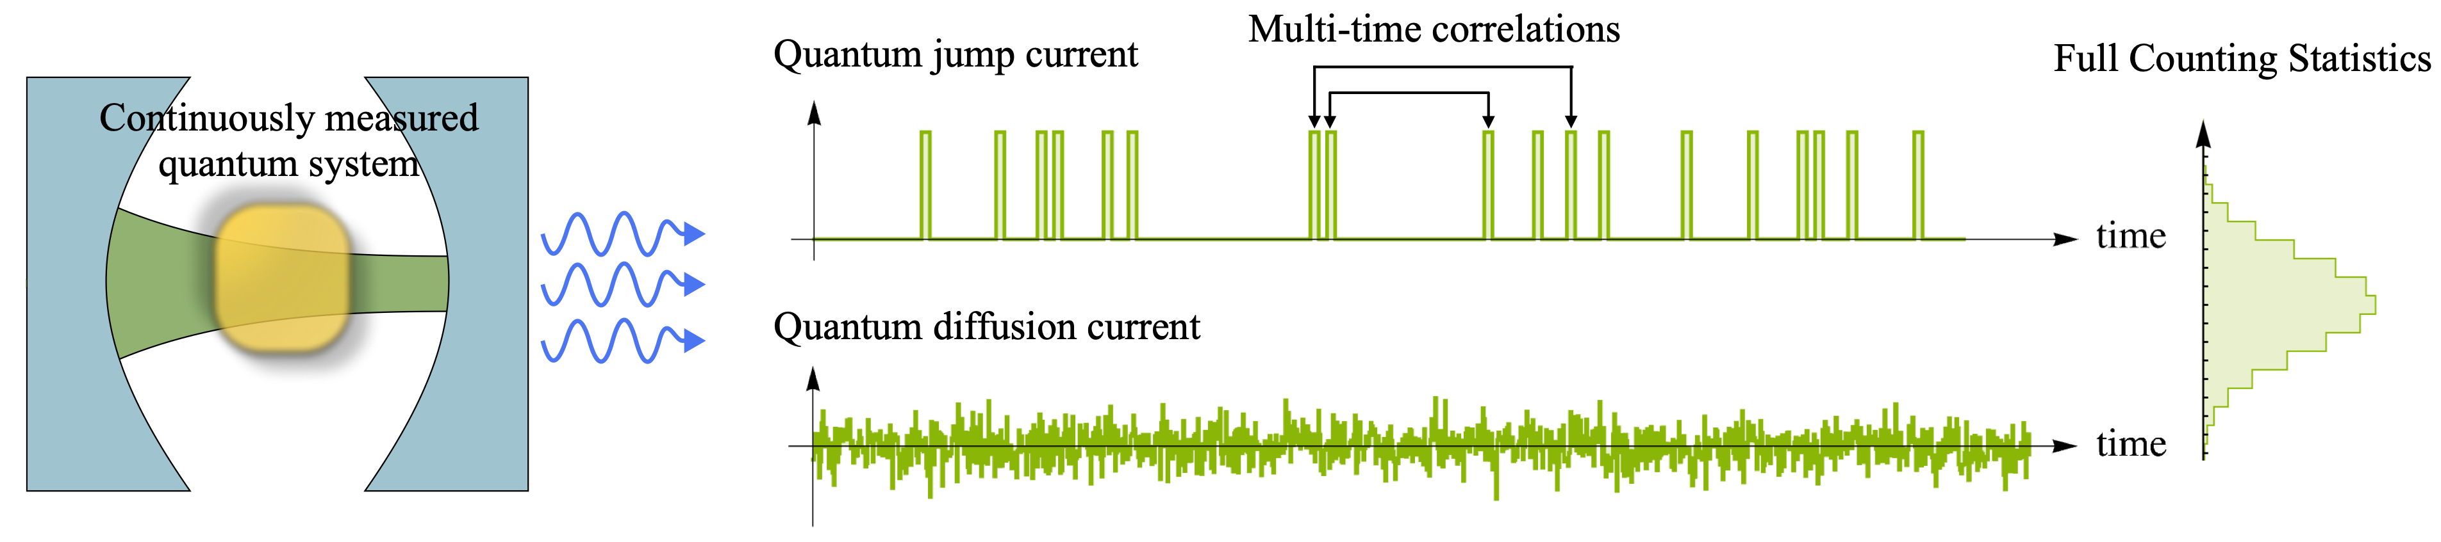
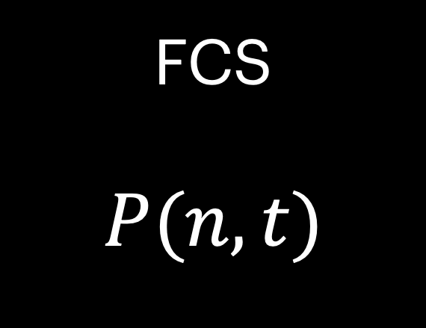
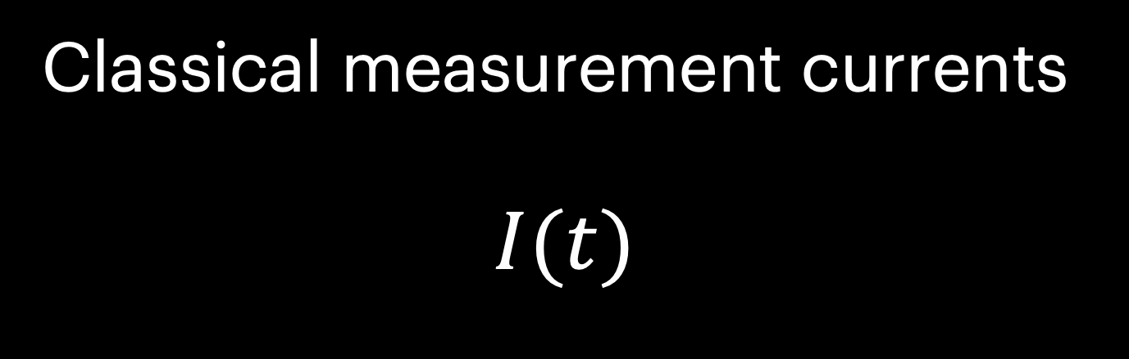
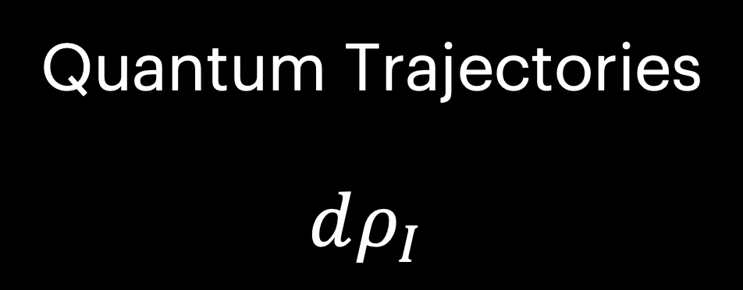
Quantum Trajectories
$dρ_{I}$
Classical measurement currents
$$I(t)$$
FCS
$$P(n,t)$$

Slide 4
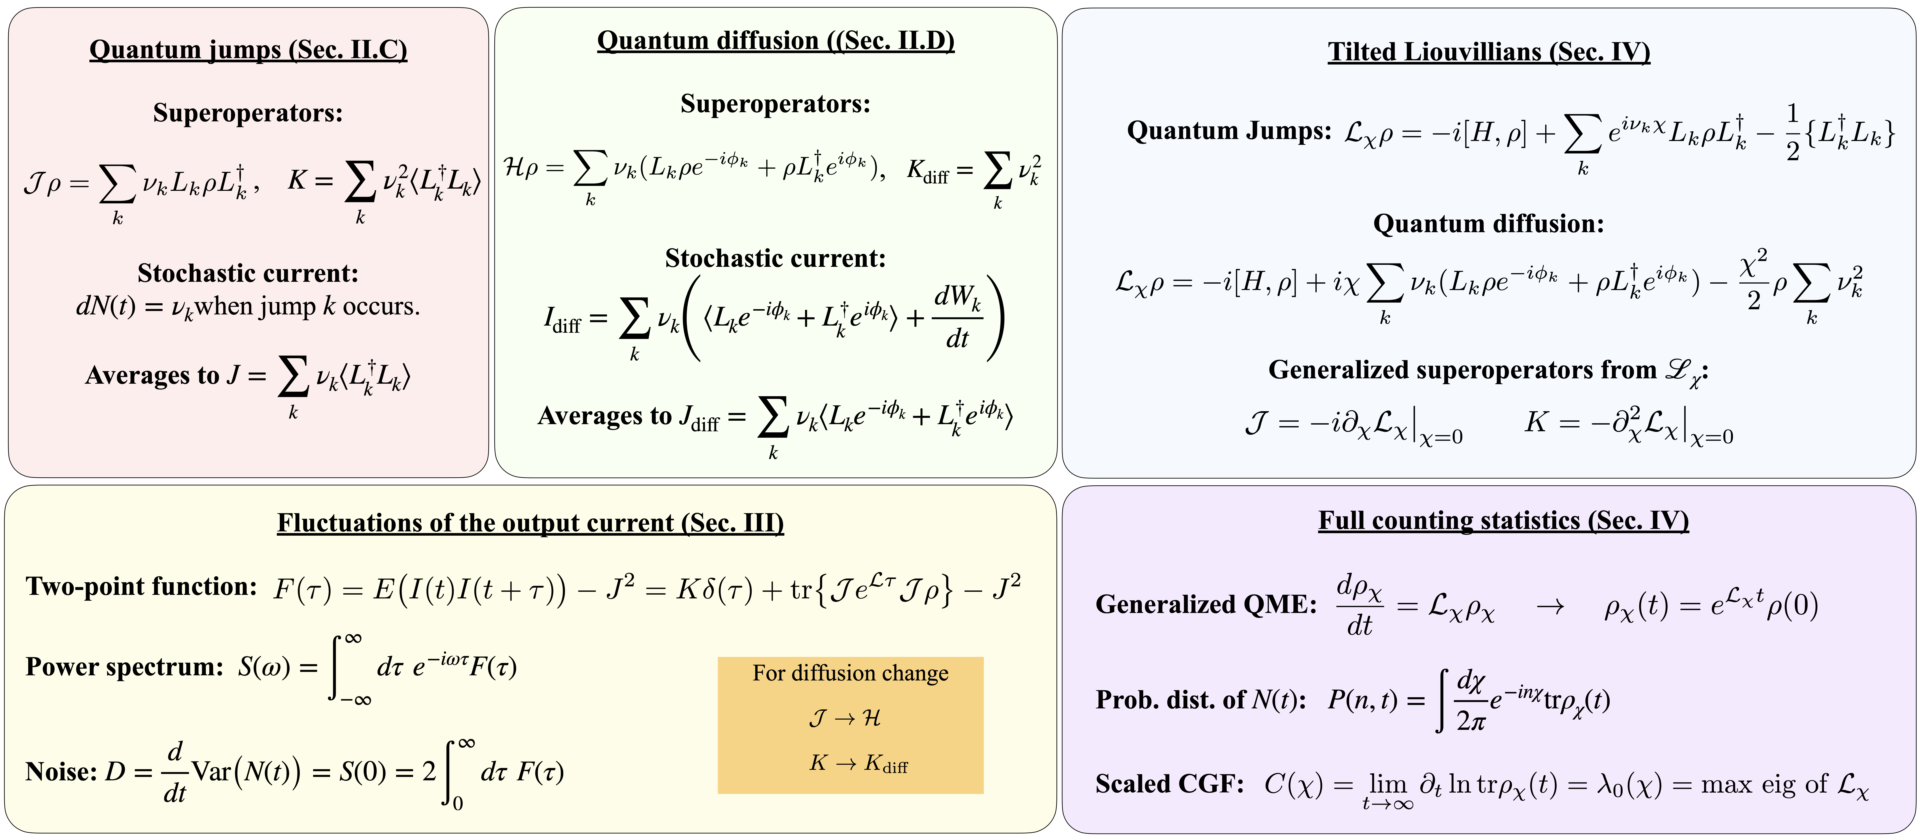
All the mathematics that you will learn

Slide 5
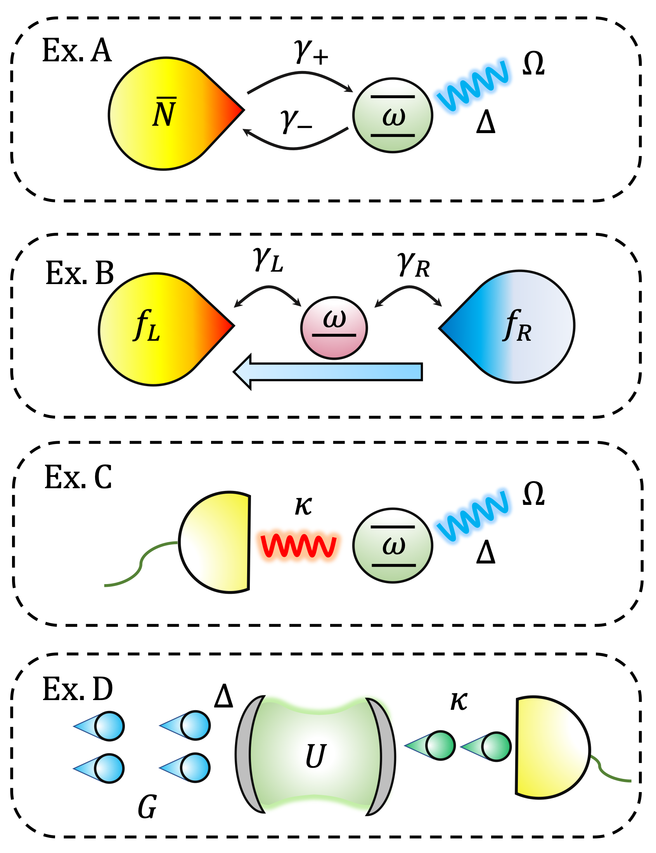
Learning through simple models:
qubits, dots, and leaky cavities

Slide 6

Everyone loves a Qubit

Slide 7
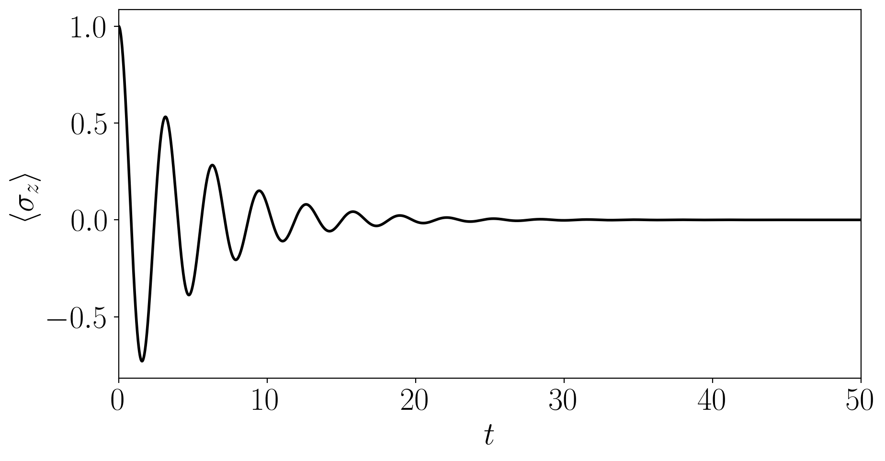
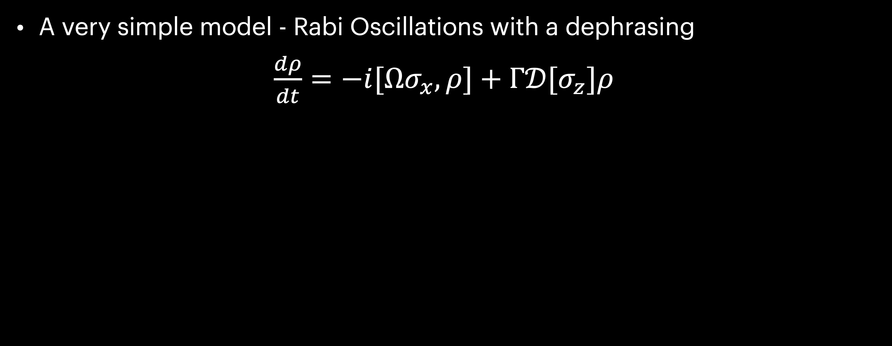
Dephasing Qubit
A very simple model - Rabi Oscillations with a dephrasing
$\frac{dρ}{dt}=−i[Ωσ_{x},ρ]+Γ𝒟[σ_{z}]ρ$

Slide 8
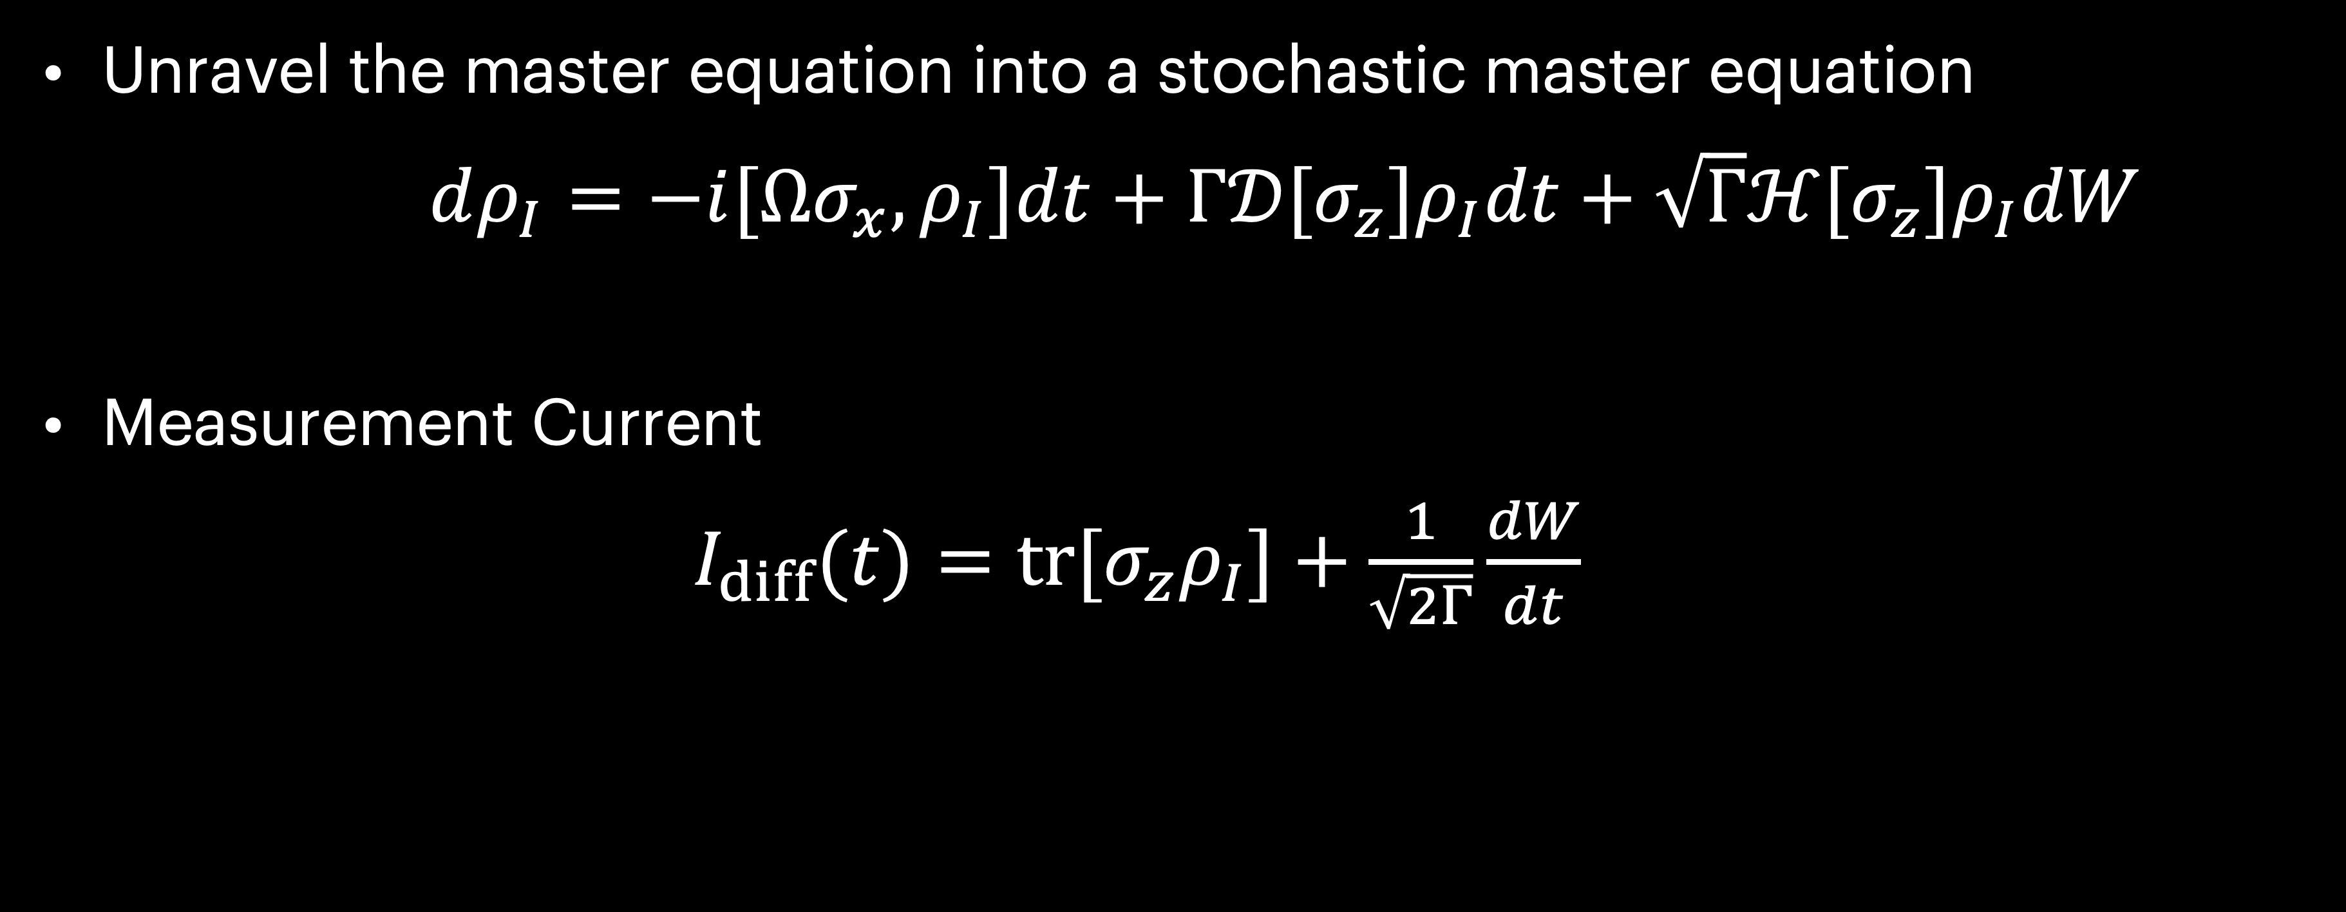
Dephasing Qubit
Unravel the master equation into a stochastic master equation
$dρ_{I}=−i[Ωσ_{x},ρ_{I}]dt+Γ𝒟[σ_{z}]ρ_{I}dt+\sqrt{Γ}ℋ[σ_{z}]ρ_{I}dW$
Measurement Current
$I_{diff}(t)=tr[σ_{z}ρ_{I}]+\frac{1}{\sqrt{2Γ}}\frac{dW}{dt}$

Slide 9
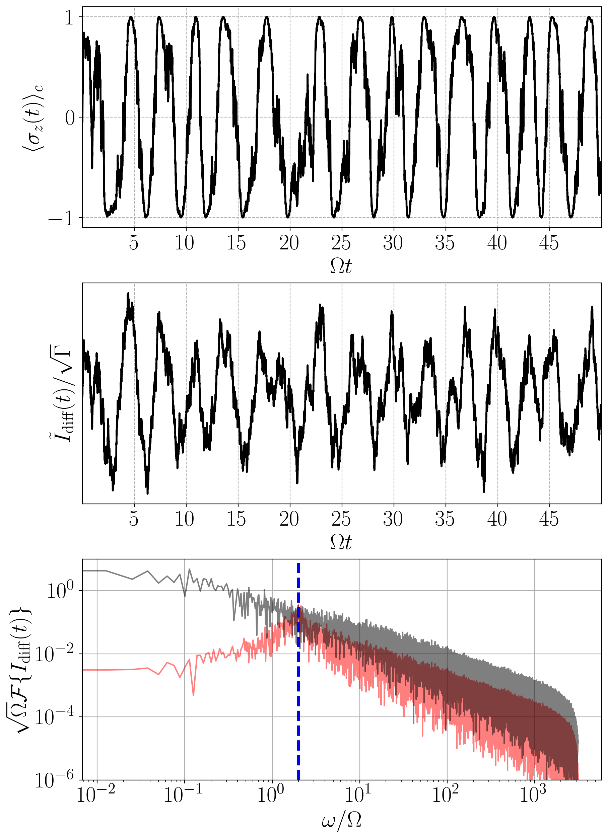
Dephasing Qubit
Trajectories and output currents
Quantum Trajectory
Filtered Measurement Current

Slide 10
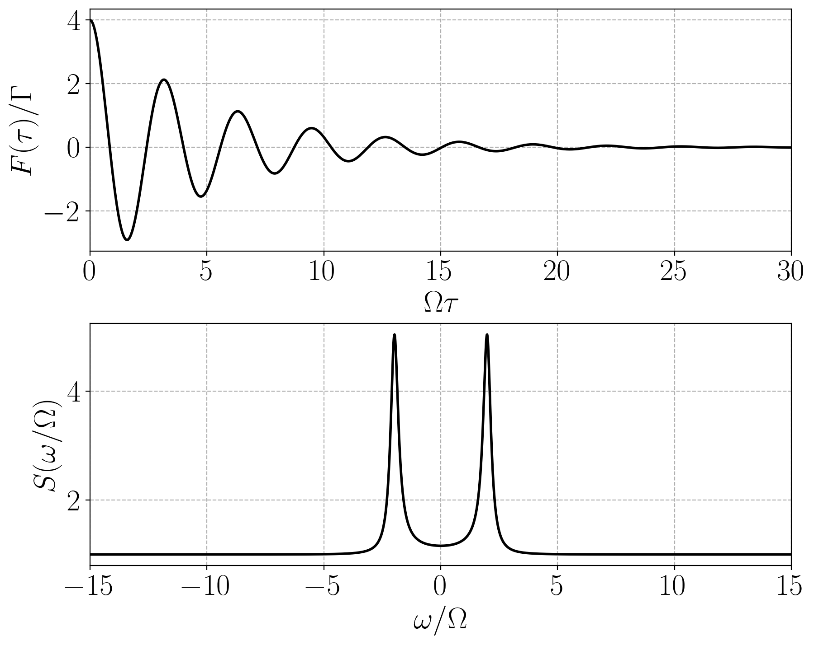
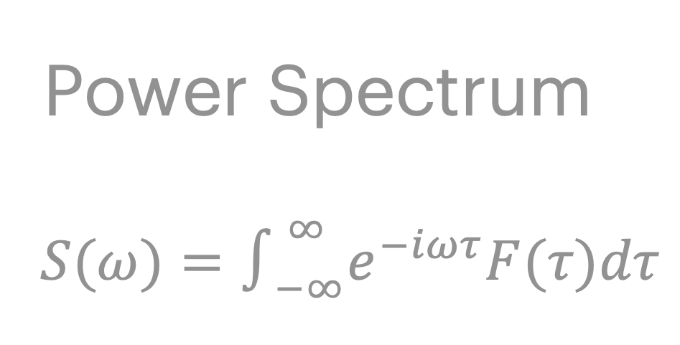
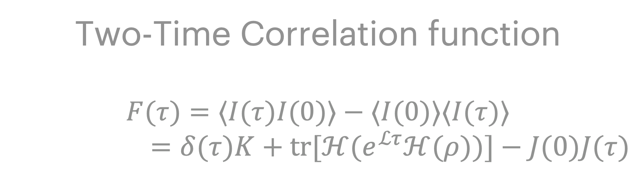
Dephasing Qubit
Two time correlation function and the PS
Two-Time Correlation function
$$F(τ)=⟨I(τ)I(0)⟩−⟨I(0)⟩⟨I(τ)⟩$$
$=δ(τ)K+tr[ℋ(e^{ℒτ}ℋ(ρ))]−J(0)J(τ)$
Power Spectrum
$$S(ω)=∫_{−∞}^{∞}e^{−iωτ}F(τ)dτ$$
Measures temporal correlations
Peaks ~ Rabi frequency

Slide 11
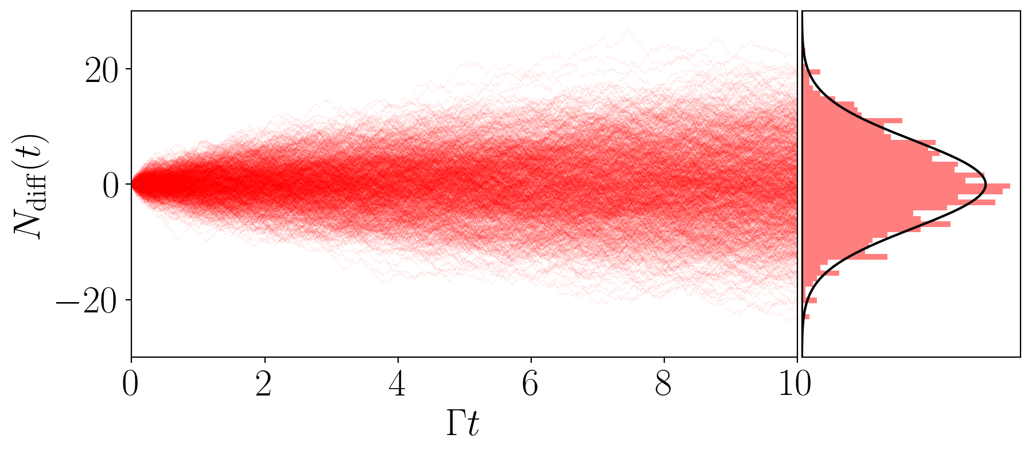

Dephasing Qubit
The noise
The Noise $D=S(0)$
Variance in integrated current in long time limit $Var[N(t)]=Dt$

Slide 12
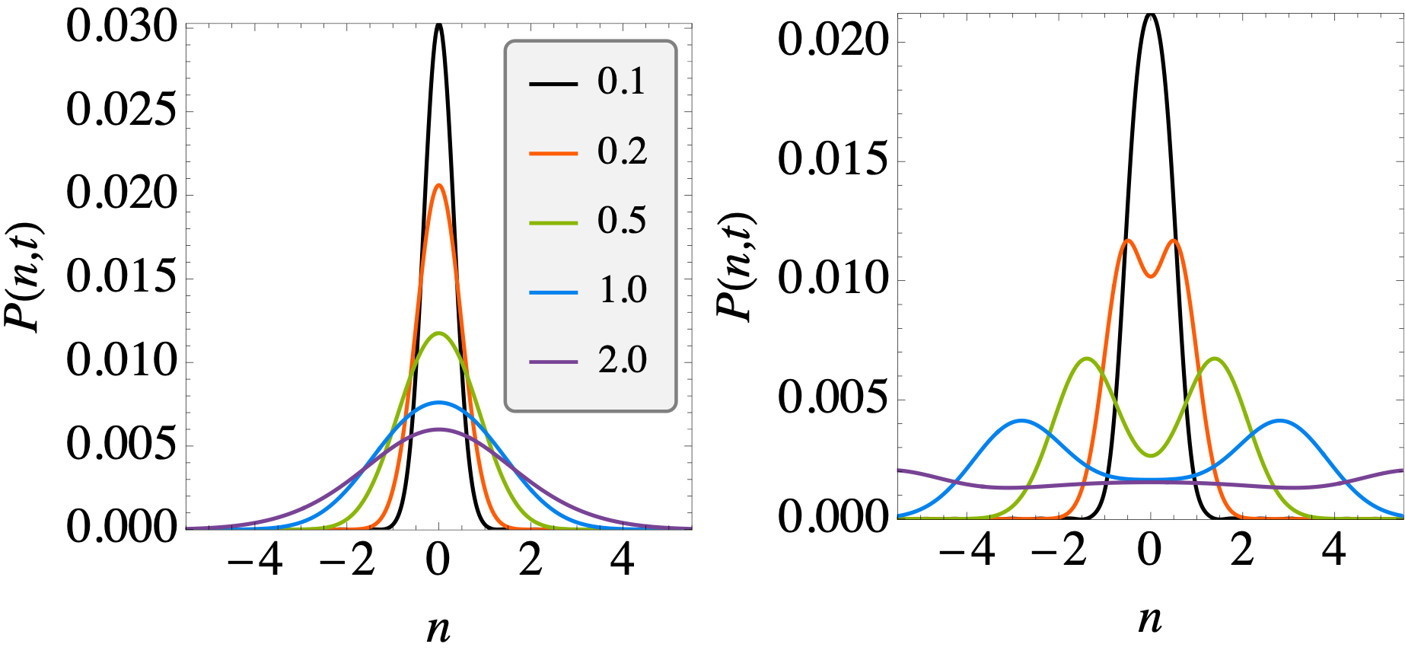
Dephasing Qubit
Full Counting Statistics
Full distribution of integrated current can be compute from the tilted Liouvillian
$P(n,t)=∫_{−∞}^{∞}\frac{dχ}{2π}e^{−iχn}tr[ρ_{χ}(t)]$ where $\frac{dρ_{χ}(t)}{dt}=−i[H,ρ_{χ}]+iχℋρ_{χ}−\frac{χ^{2}}{2}Kρ_{χ}$

Slide 13
The topics in this tutorial
Pedagogical overview of Stochastic Quantum Master Equations (jumps, diffusion)
Understanding continuous quantum measurements and output currents (charge counting, diffusive measurements)
Describe how one can key key statistical quantities of output currents (two-time correlation functions, power spectrum)
Computation of higher order moments/distribution of outcomes (Full Counting statistics, tilted Liouvillian)
Numerous methods and techniques to evaluate all these concepts.

Slide 14
Thank you! : arXiv:2303.04720

